Slide 1
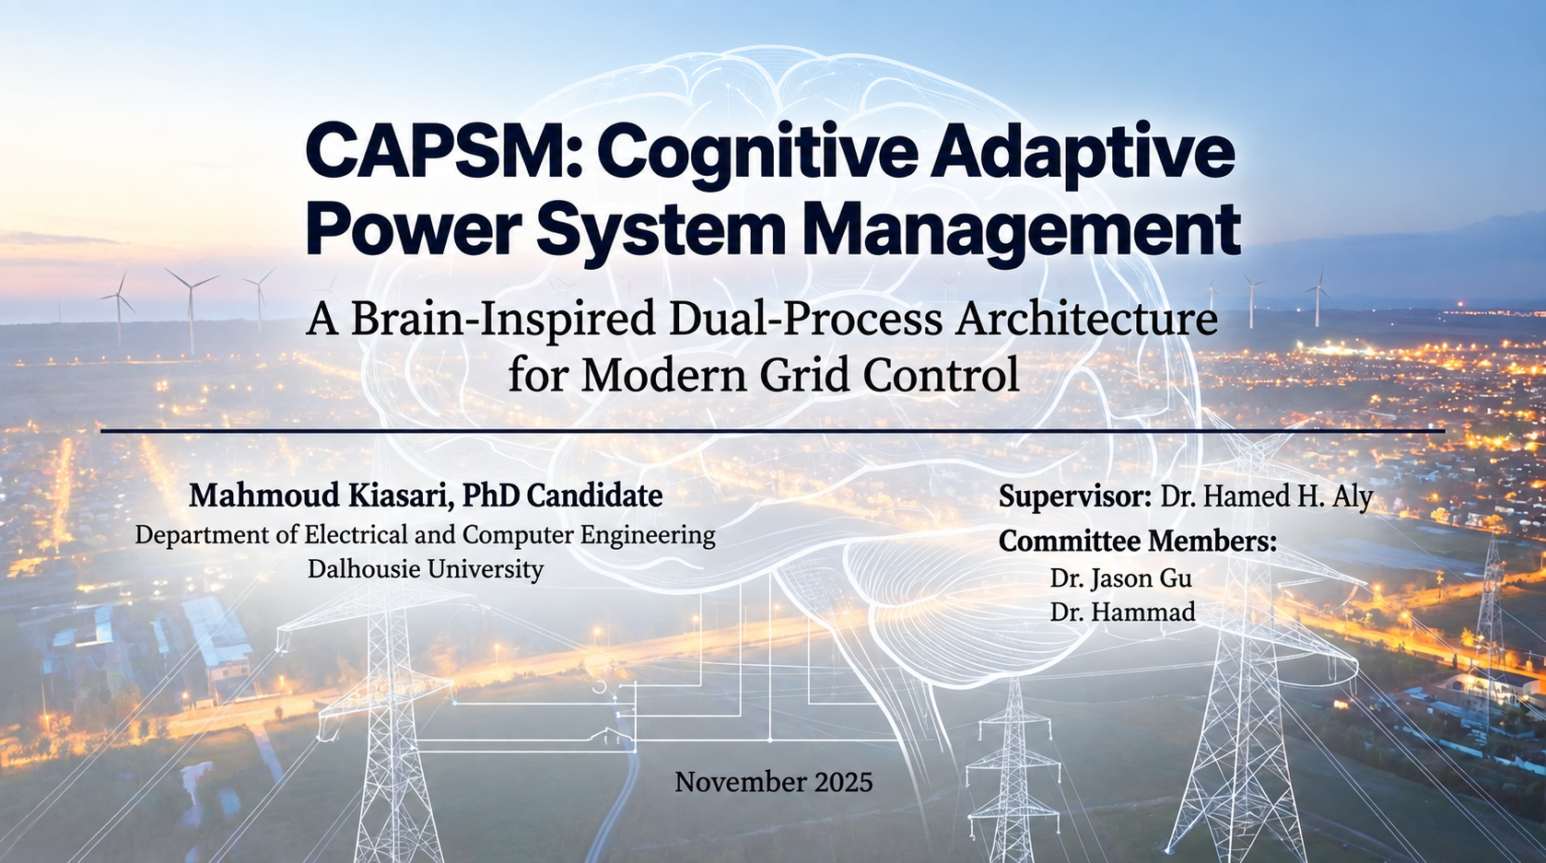

Sep 2026
1

Slide 2
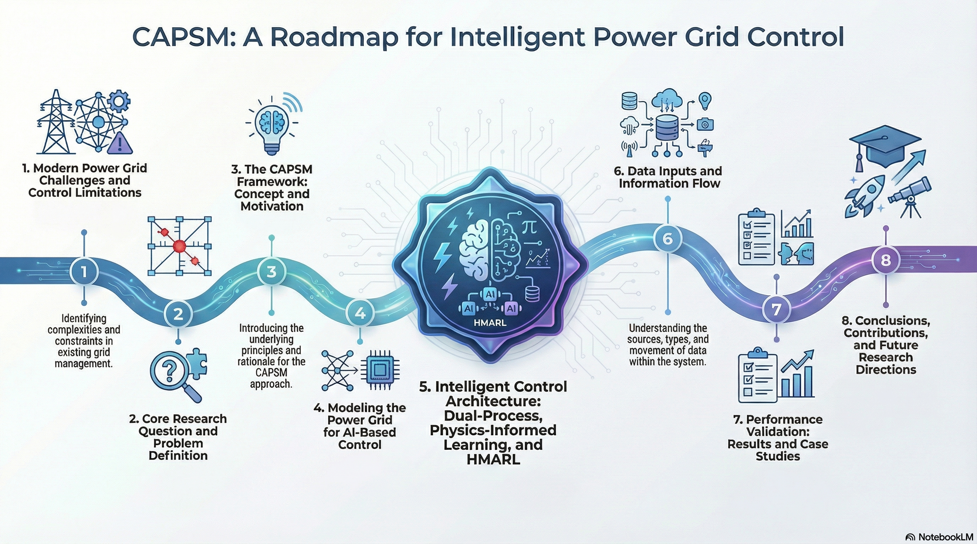
2

Slide 3
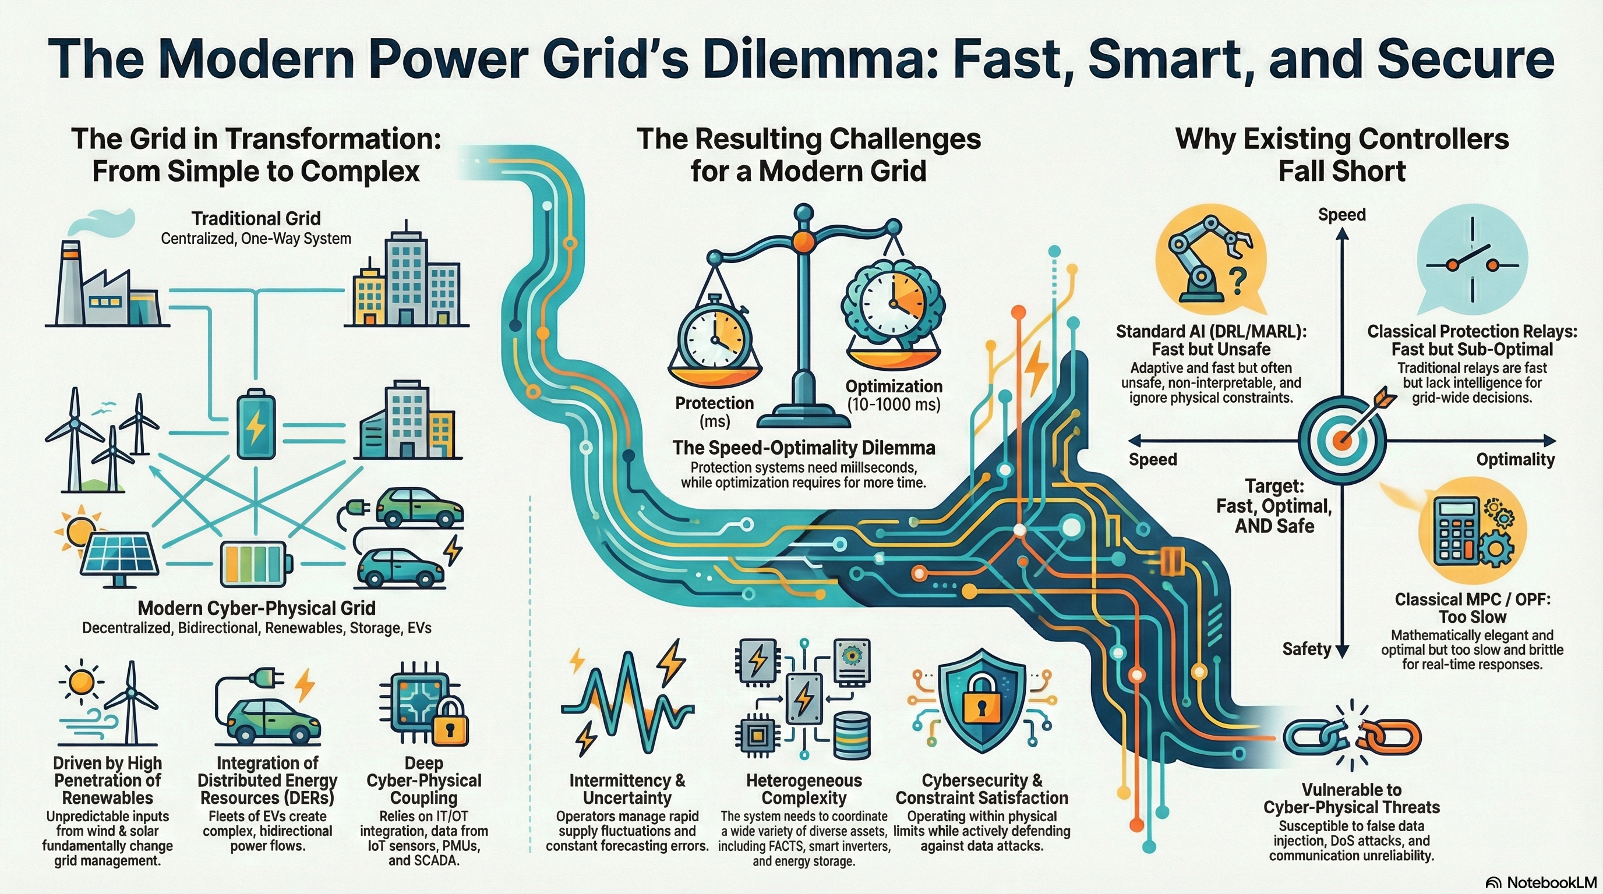
3

Slide 4
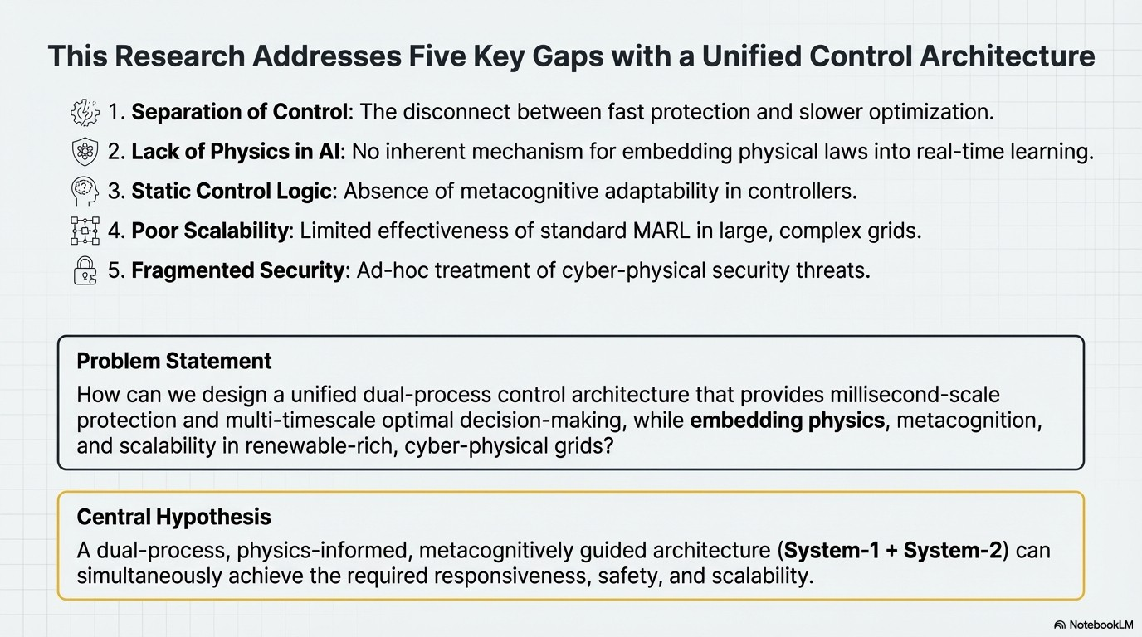
4

Slide 5
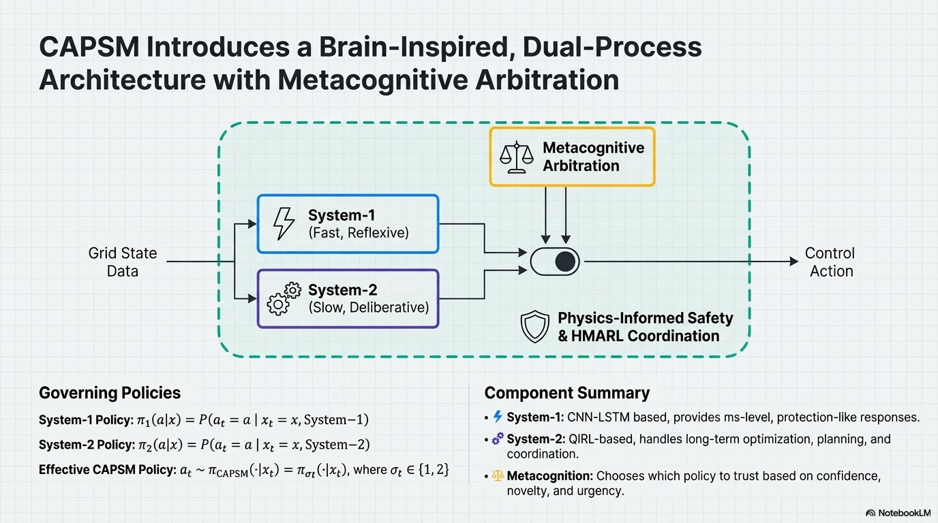
5
Notes:
CAPSM works by allowing two different styles of intelligence to look at the same power-system condition at the same time. System 1 behaves like an experienced operator's reflex: it recognizes familiar patterns and produces a very fast response when immediate action is needed. System 2 behaves more like an engineer performing a short analysis before acting: it considers alternative control actions, evaluates their expected consequences, and selects a more deliberate response. Both systems can coordinate controllable resources such as FACTS devices and aggregated EV stations, but they approach the decision from different perspectives—speed and learned experience versus evaluation and optimization.
The metacognitive layer acts like a supervisor above these two decision-making processes. Instead of always trusting one controller, it assesses the condition of the grid and determines how much each recommendation should influence the final action. The resulting command is then checked against physical and operational limits so that the controller does not request something the equipment or network cannot safely provide. In simple terms, the philosophy of CAPSM is: observe what is happening → react quickly when appropriate → think more carefully when necessary → intelligently combine the recommendations → verify that the action is physically acceptable → send the final command to the grid.

Slide 6
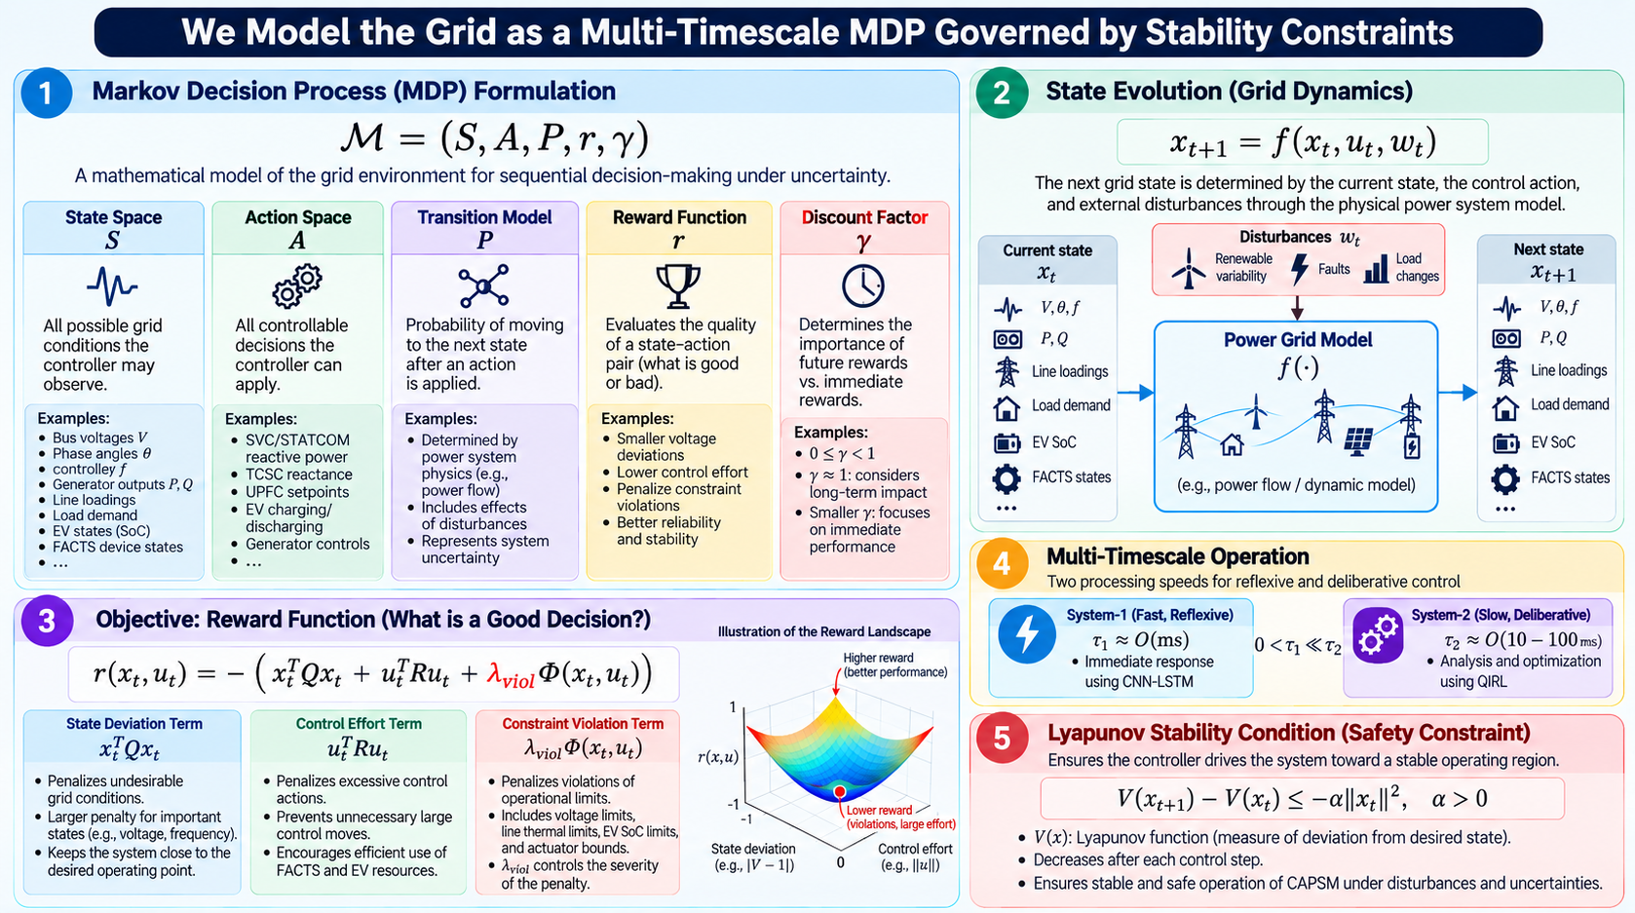
6
Notes:
This equation defines the mathematical environment in which CAPSM makes decisions. \(S\) is the set of possible grid states—different combinations of bus voltages, angles, frequency, loading, EV SoC, and other measurements. \(A\) is the set of control actions available to CAPSM, such as changing SVC/STATCOM reactive power, TCSC compensation, UPFC setpoints, or EV charging/discharging. \(P\) describes how the grid moves from one state to another after an action is applied; physically, this transition is governed by the power-system model rather than being arbitrary. \(r\) tells the controller whether a decision was good or bad. Finally, \(\gamma\) is the discount factor: a value close to 1 means future consequences remain important, while a smaller value makes the controller care more about immediate performance.

Slide 7
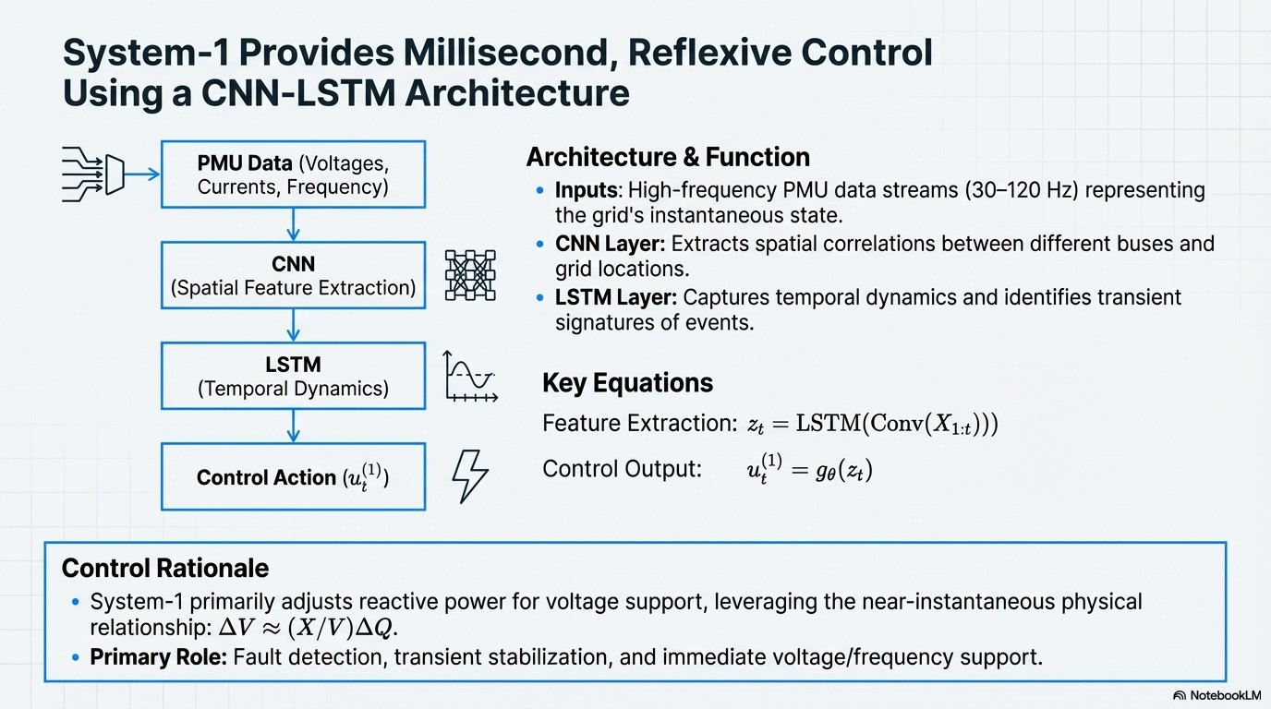
7
Notes:
System 1 is the fast, reflexive control pathway of CAPSM. It receives a short sequence of recent grid measurements, such as voltages, currents, and frequency. The CNN first identifies important spatial relationships and patterns across different grid locations; the LSTM then learns how those patterns evolve over time and captures transient behavior. The attention layer emphasizes the most relevant information, particularly during disturbances, and the final output layer converts these learned features into the 9-dimensional control action for the FACTS devices and EV stations. In simple terms, System 1 follows the chain measure the grid → recognize spatial patterns → understand their temporal evolution → focus on what matters → rapidly generate the control response.

Slide 8
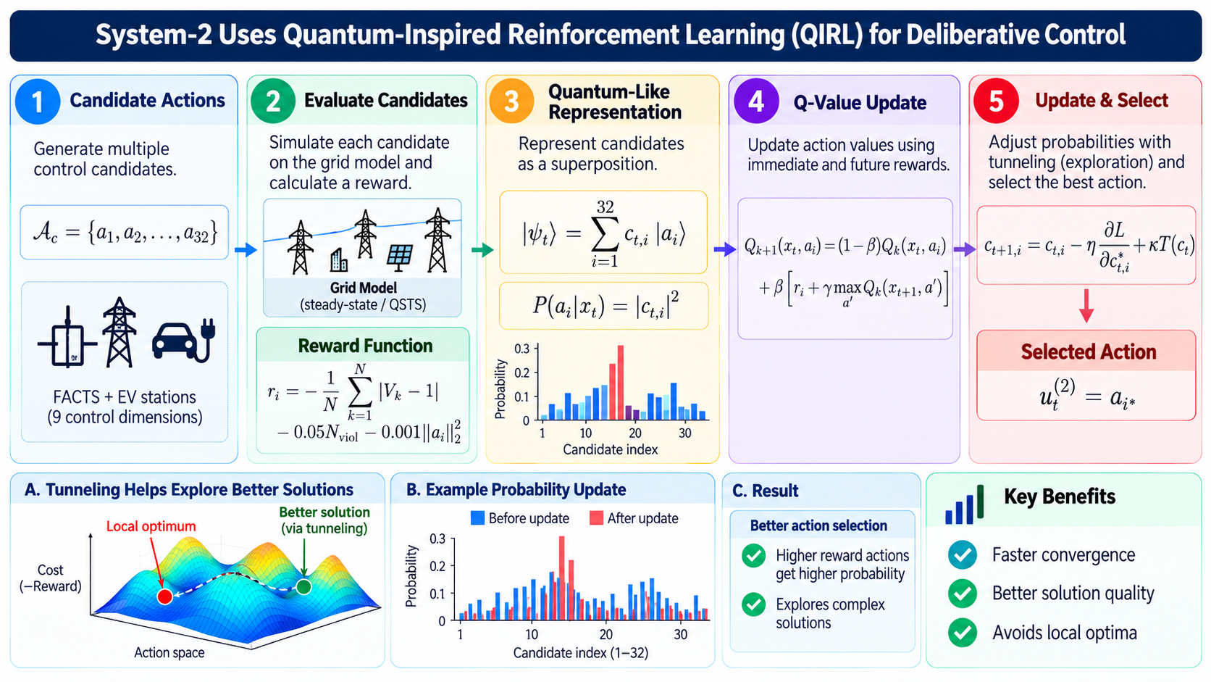
8
Notes:
System 2 is the deliberative decision-making part of CAPSM, designed to evaluate several possible control actions rather than immediately responding with a single learned action. In the current implementation, QIRL considers 32 candidate actions representing different combinations of FACTS and EV control commands. Each candidate is applied to the grid model and evaluated using a reward function that considers three main objectives: keeping bus voltages close to their desired values, reducing voltage-limit violations, and avoiding unnecessarily large control actions. The candidates are represented using quantum-inspired probability amplitudes, so multiple possible solutions remain under consideration and actions producing better rewards progressively receive higher probability.
The key advantage of this approach is exploration before committing to a control decision. Instead of becoming concentrated too early around one solution, the quantum-inspired tunnelling/reinitialization mechanism helps System 2 continue exploring other regions of the control space that may contain better solutions. After the candidates have been evaluated and their probabilities updated, System 2 selects the preferred action and sends it to the metacognitive arbitration layer as \(u_t^{(2)}\). Therefore, the intuitive System-2 process is: generate alternatives → evaluate their impact on the grid → reward good performance → increase preference for better actions → maintain some exploration → select the control recommendation.

Slide 9
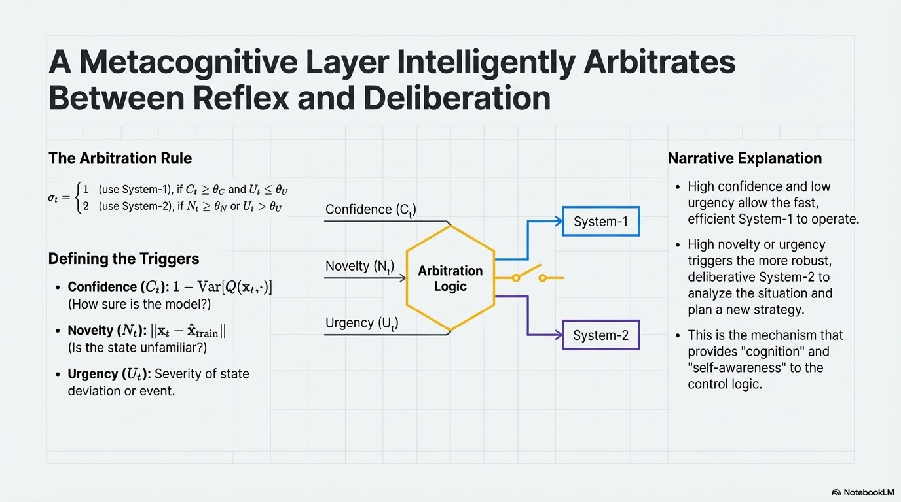
9

Slide 10
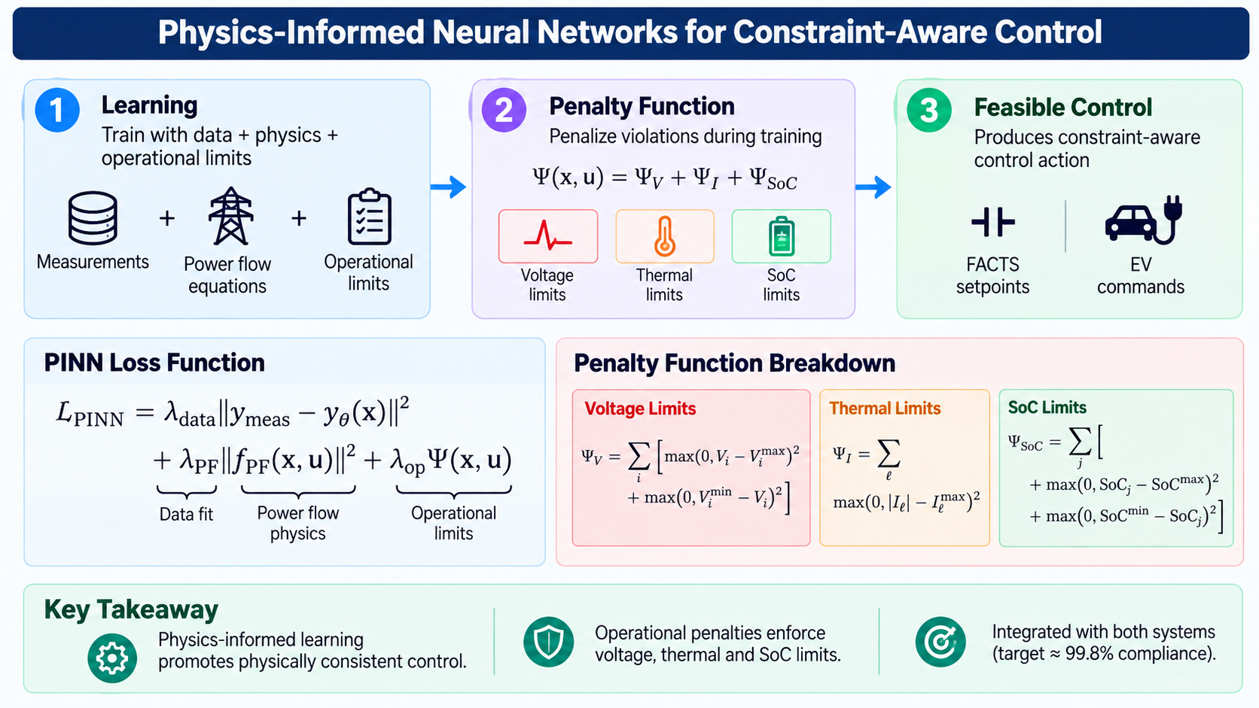
10

Slide 11
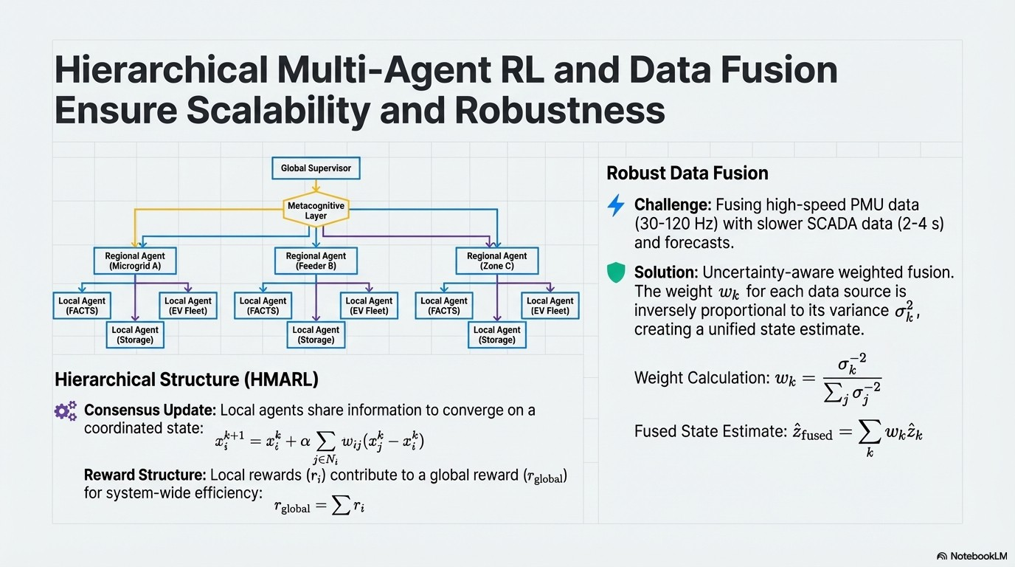
11
Notes:
The hierarchical architecture addresses control scalability, while data fusion addresses information reliability. Local agents make resource-level decisions, regional agents coordinate them, and higher layers maintain system-wide objectives. At the same time, measurements from PMU, SCADA, and other sources are combined according to their uncertainty so that CAPSM operates from a more reliable representation of the grid.

Slide 12
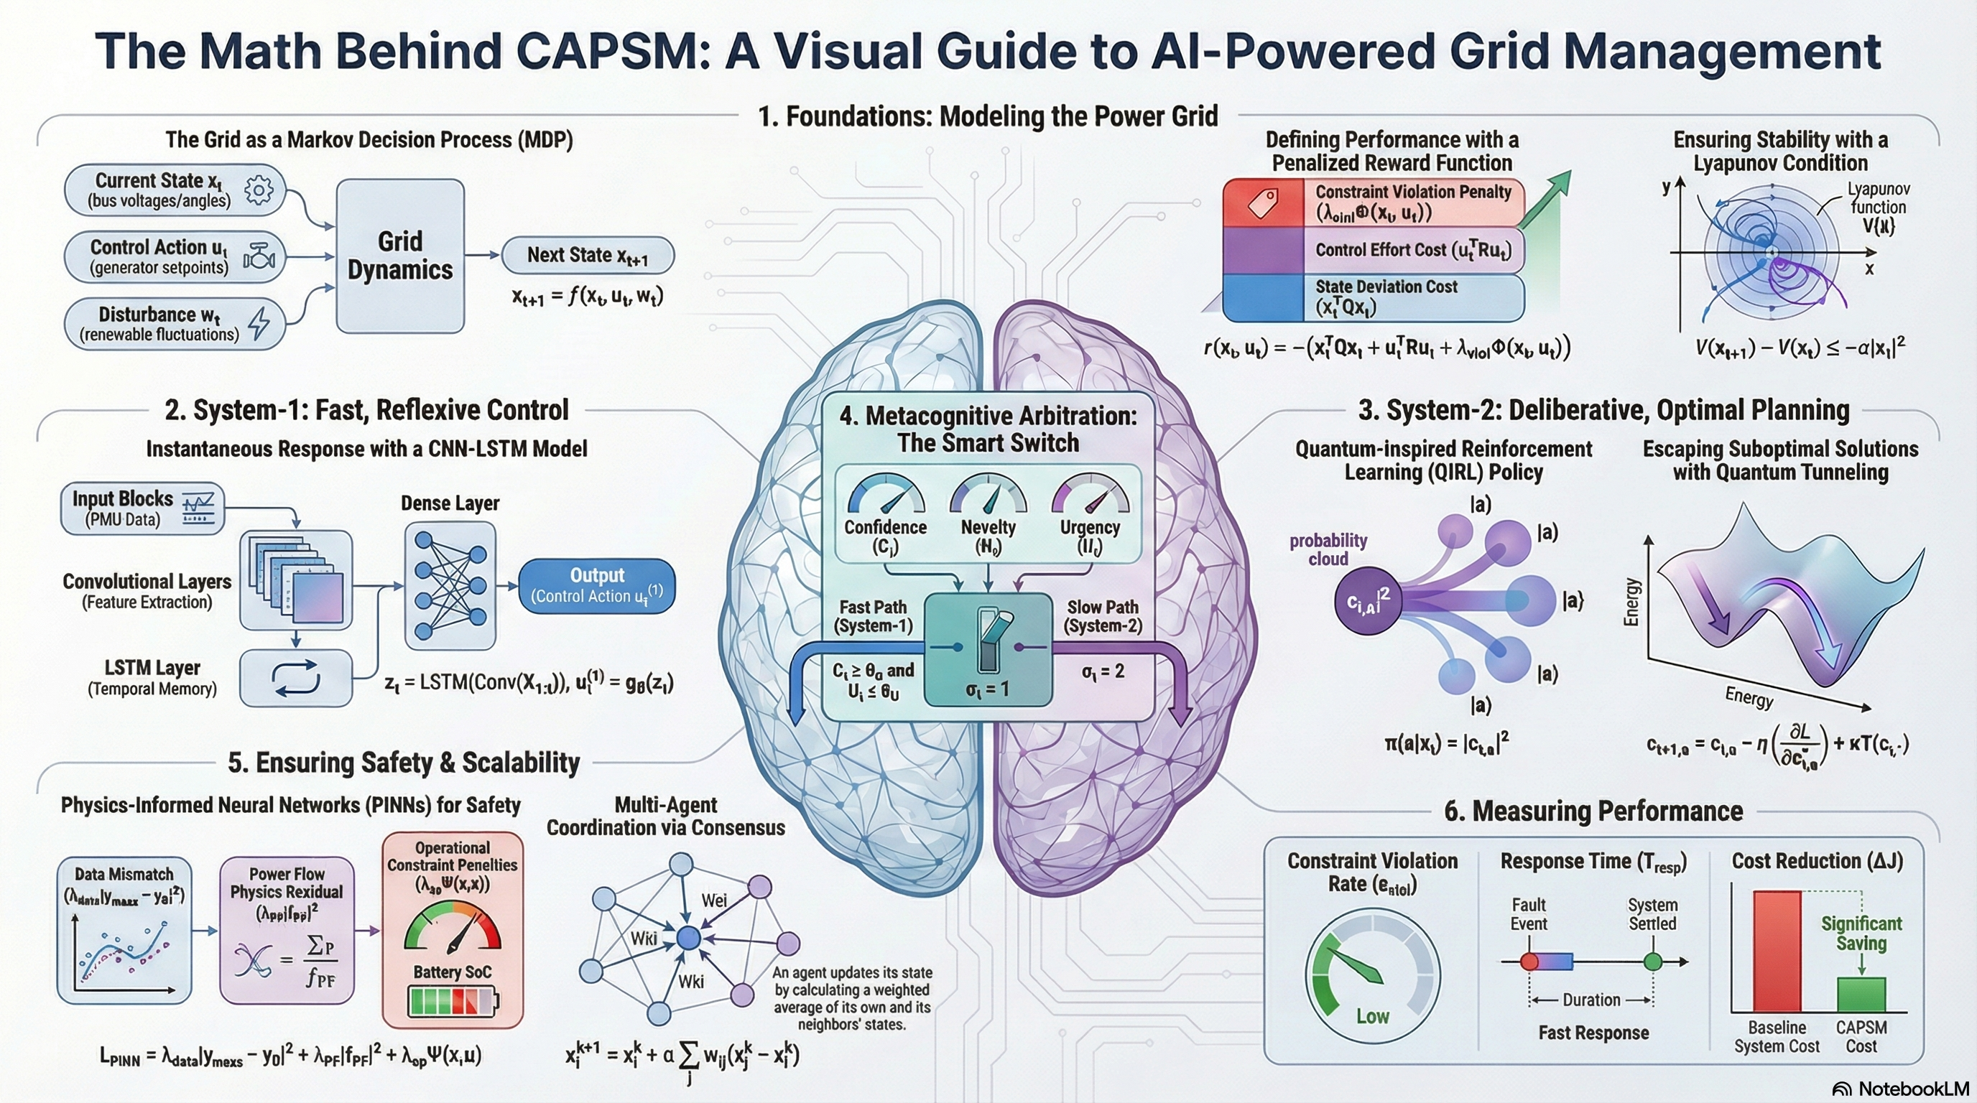
Time-table
12

Slide 13
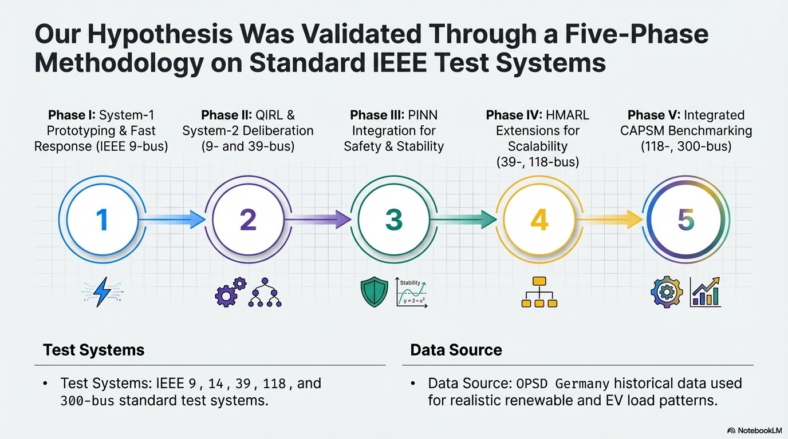
13

Slide 14
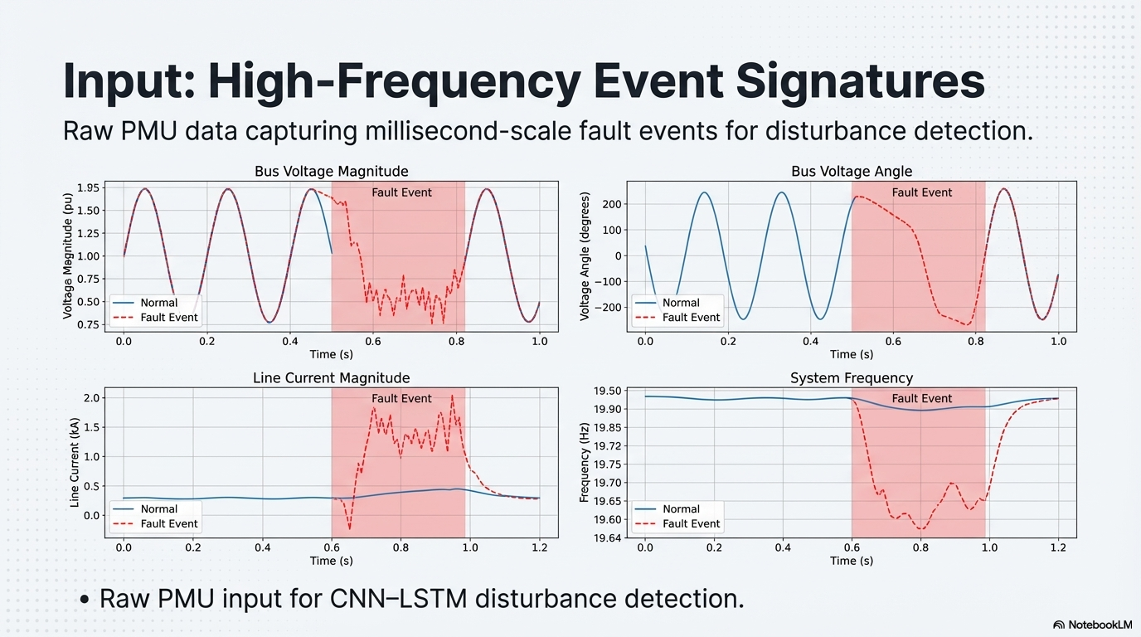
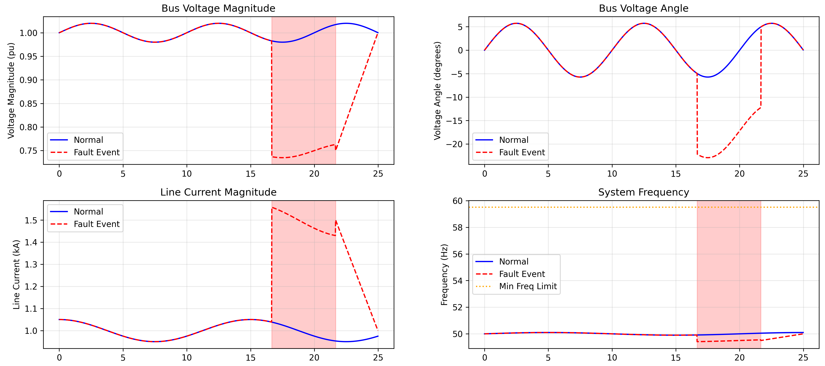
14

Slide 15
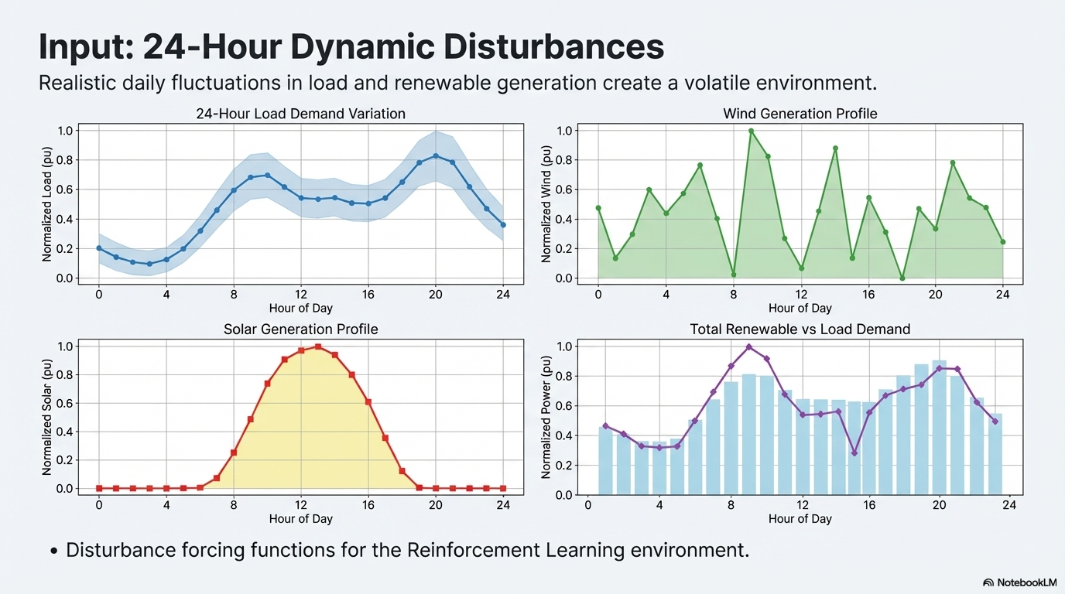
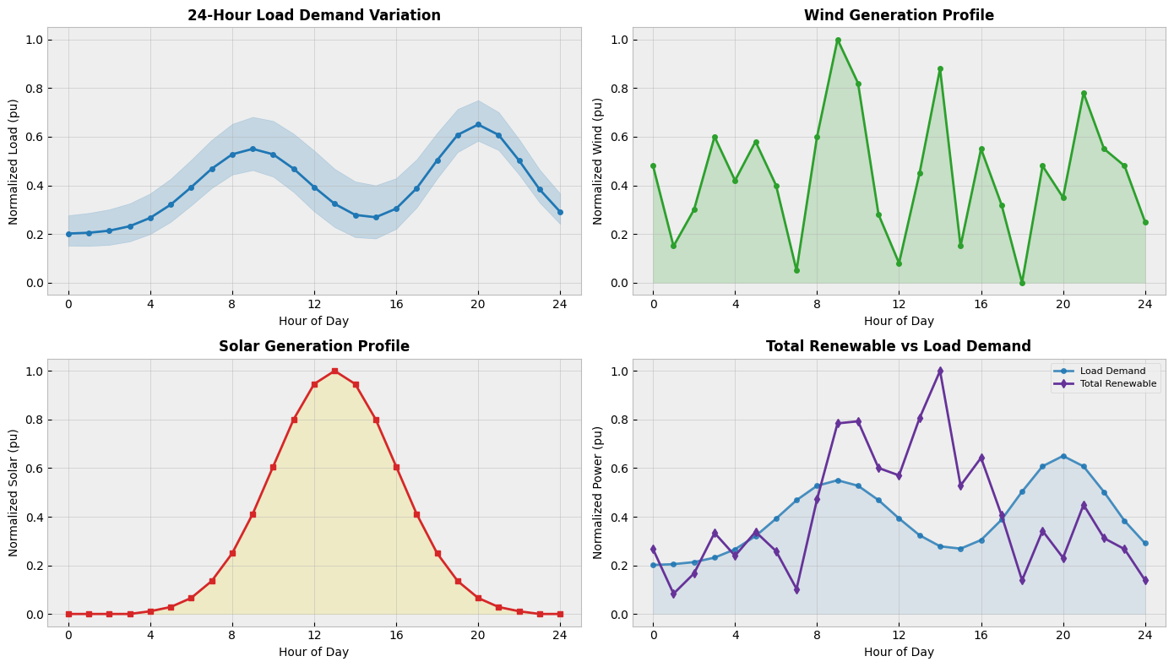
15
Notes:
Per unit expresses power relative to a selected base, allowing profiles of different magnitudes to be compared on the same scale. A value of 1 pu represents the selected reference power, while 0.5 pu represents half of that reference. For direct renewable-versus-load comparisons, I use a common power base so the normalized quantities remain physically comparable.

Slide 16
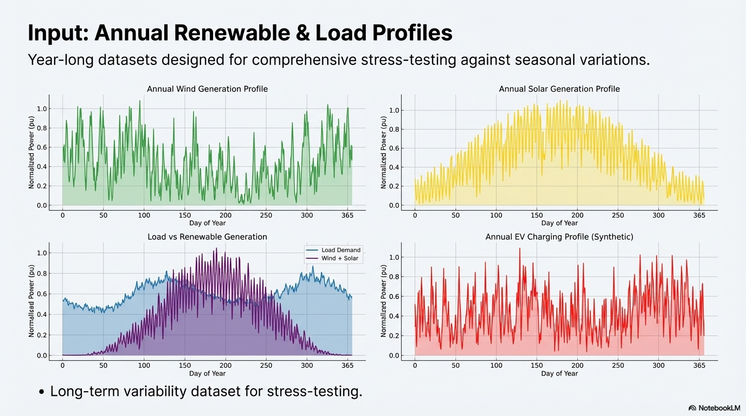
16

Slide 17
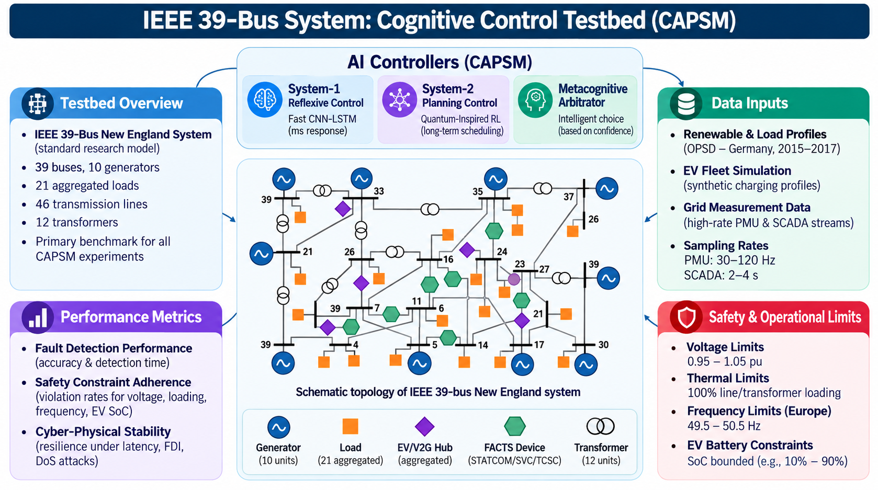
17

Slide 18
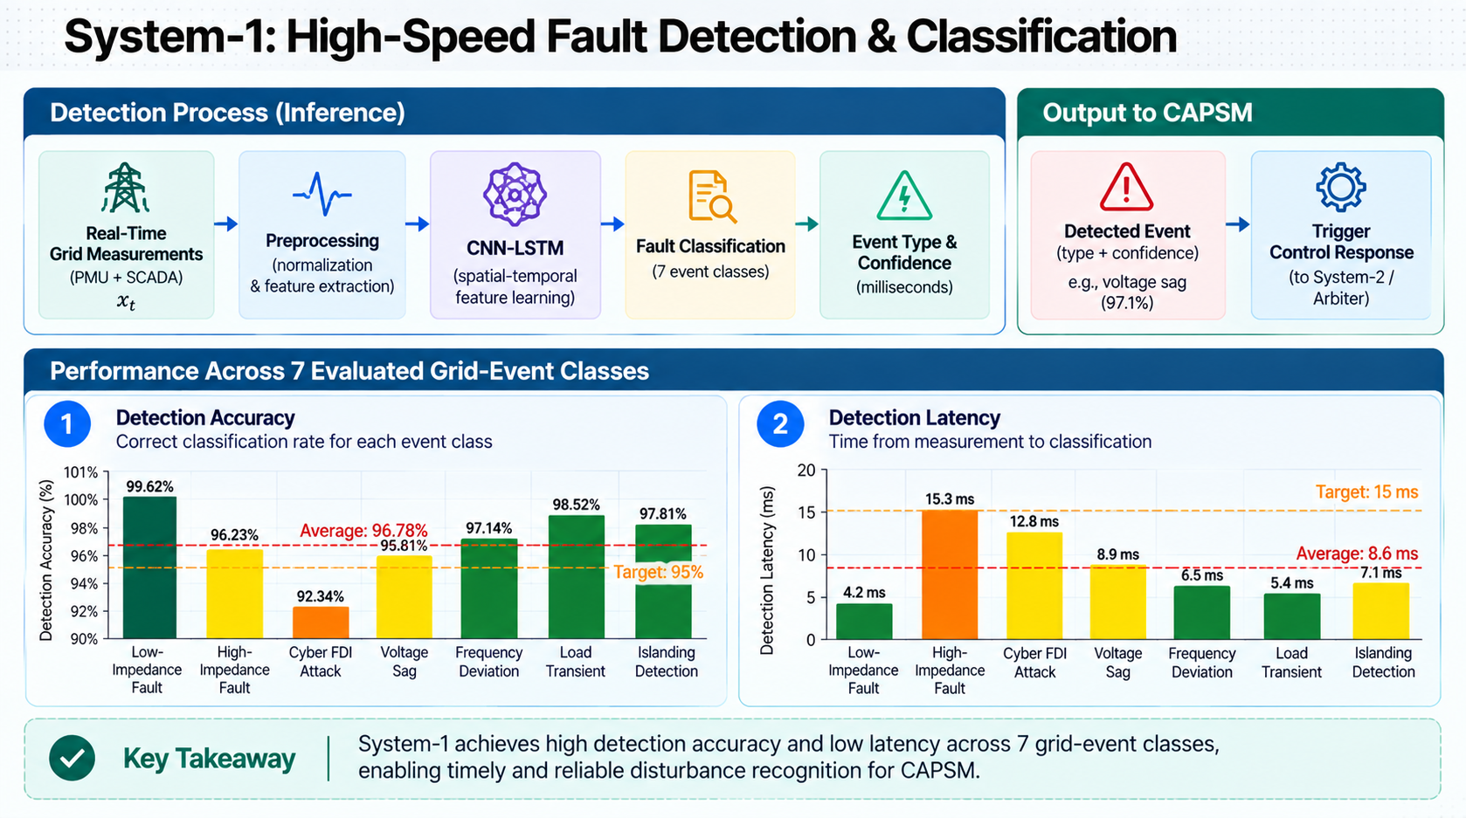
18

Slide 19
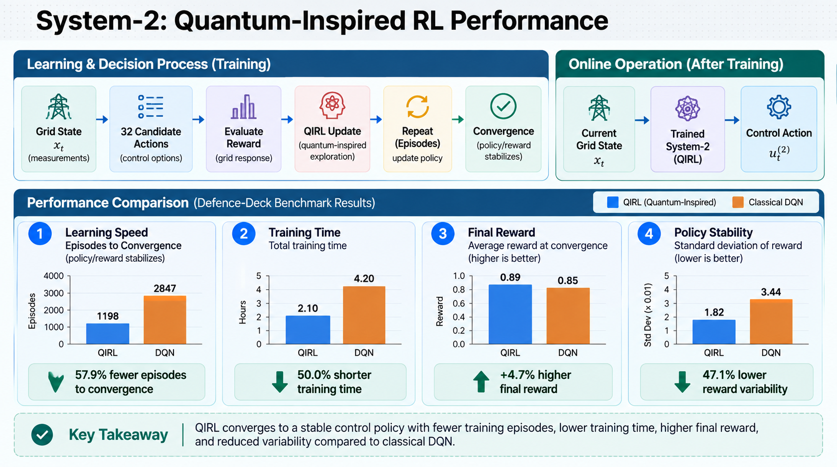
19

Slide 20
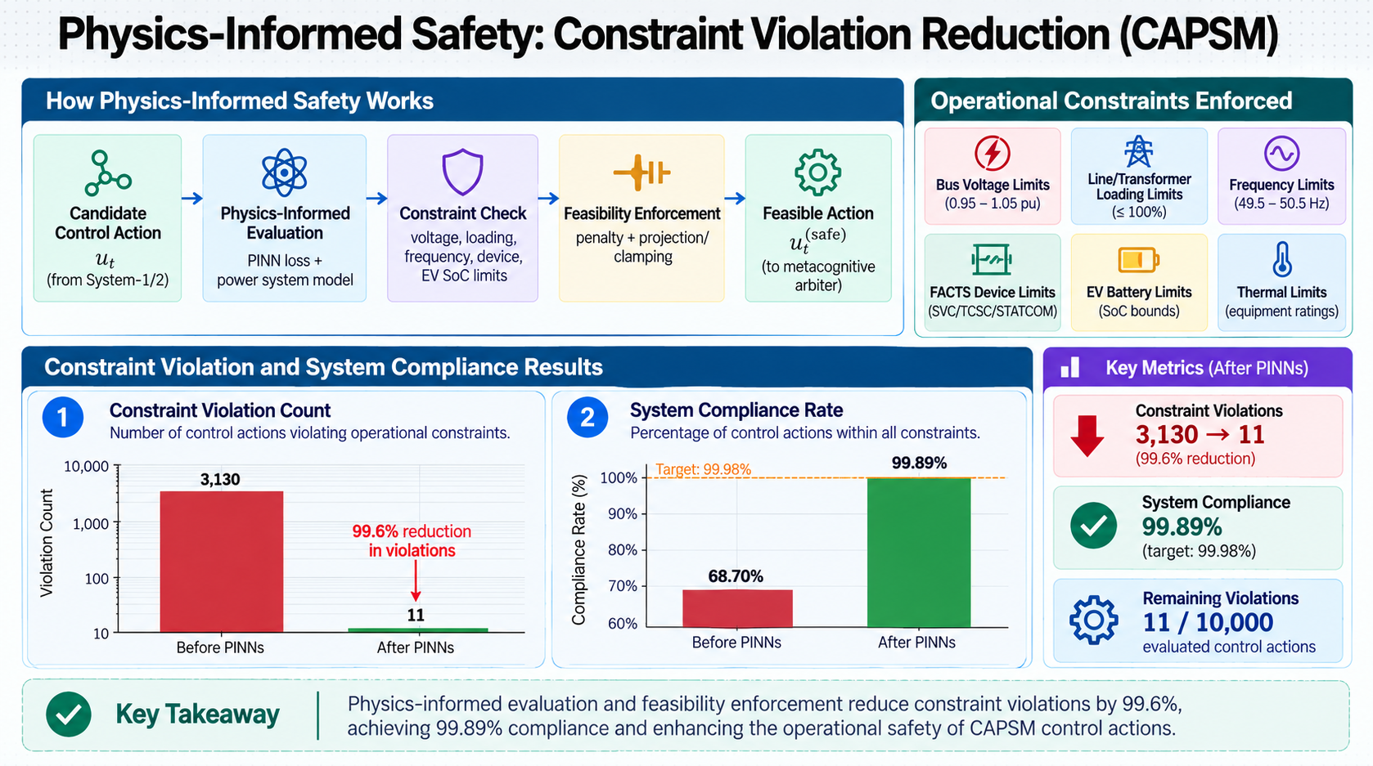
20

Slide 21
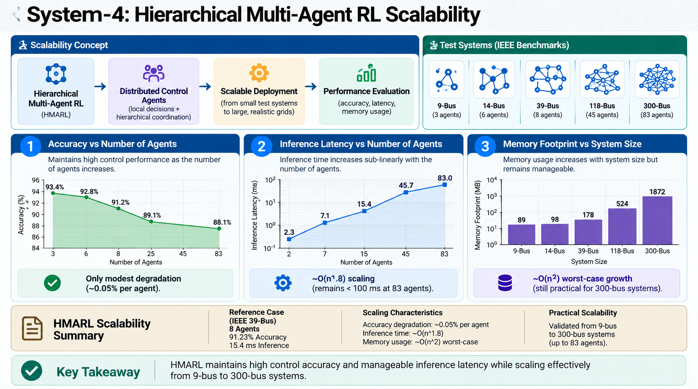
21

Slide 22
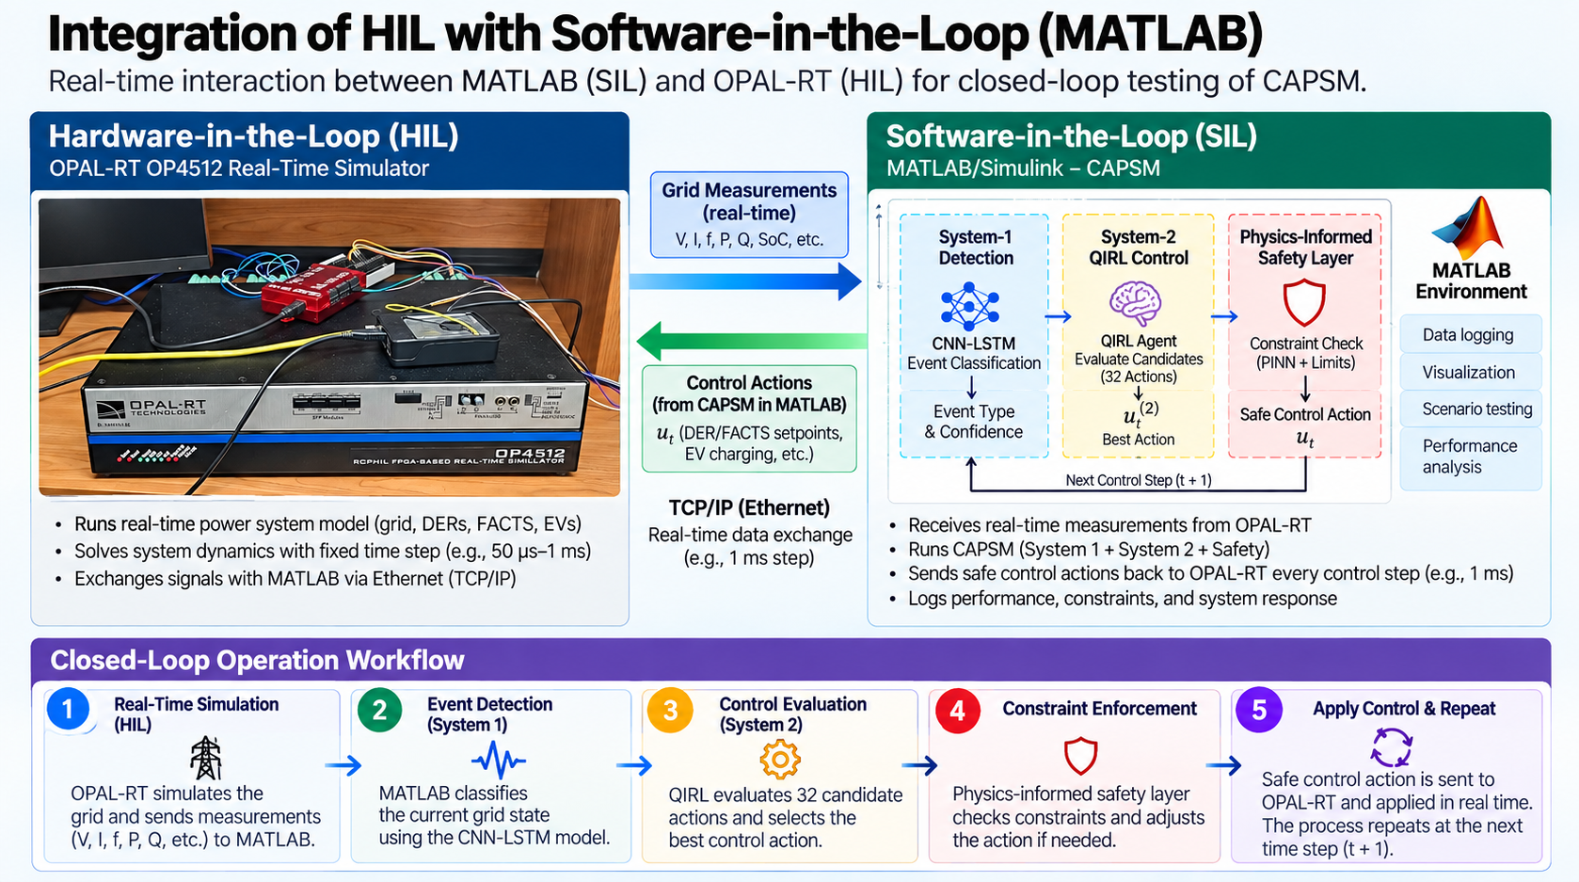
21

Slide 23
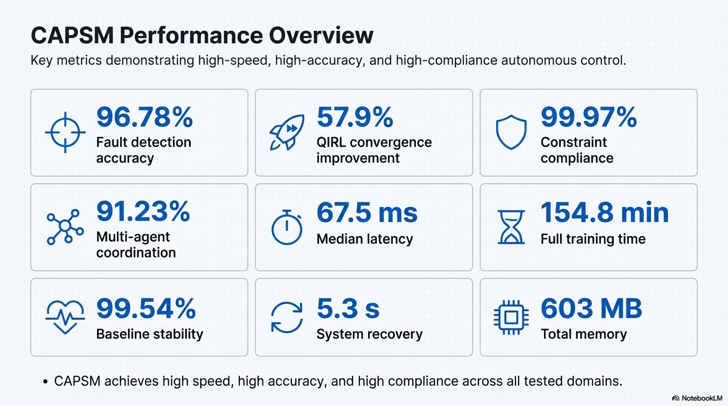
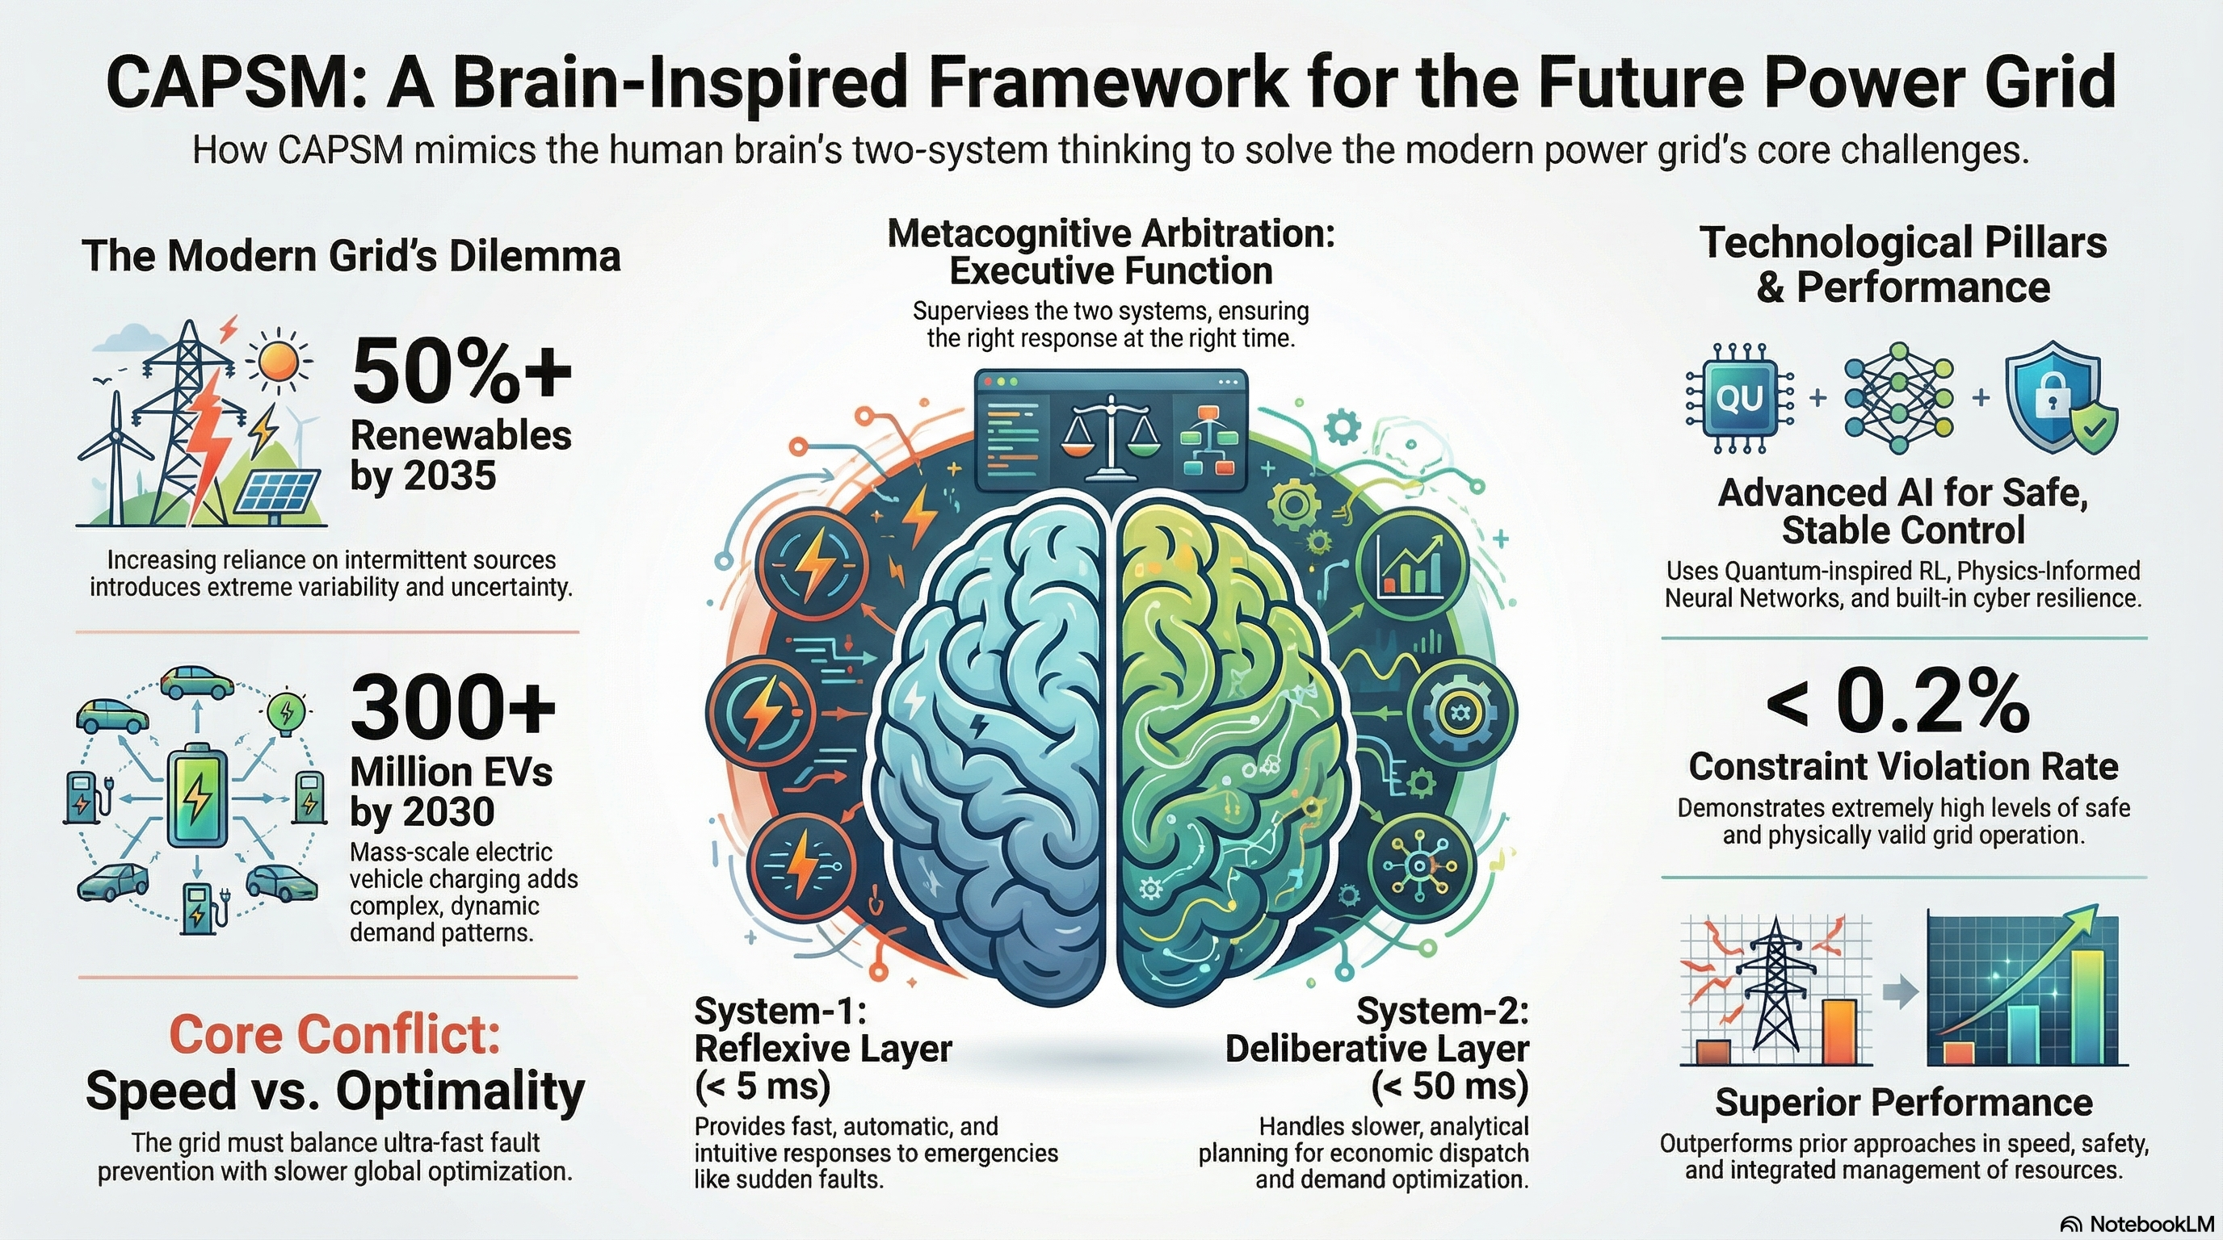
22

Slide 24
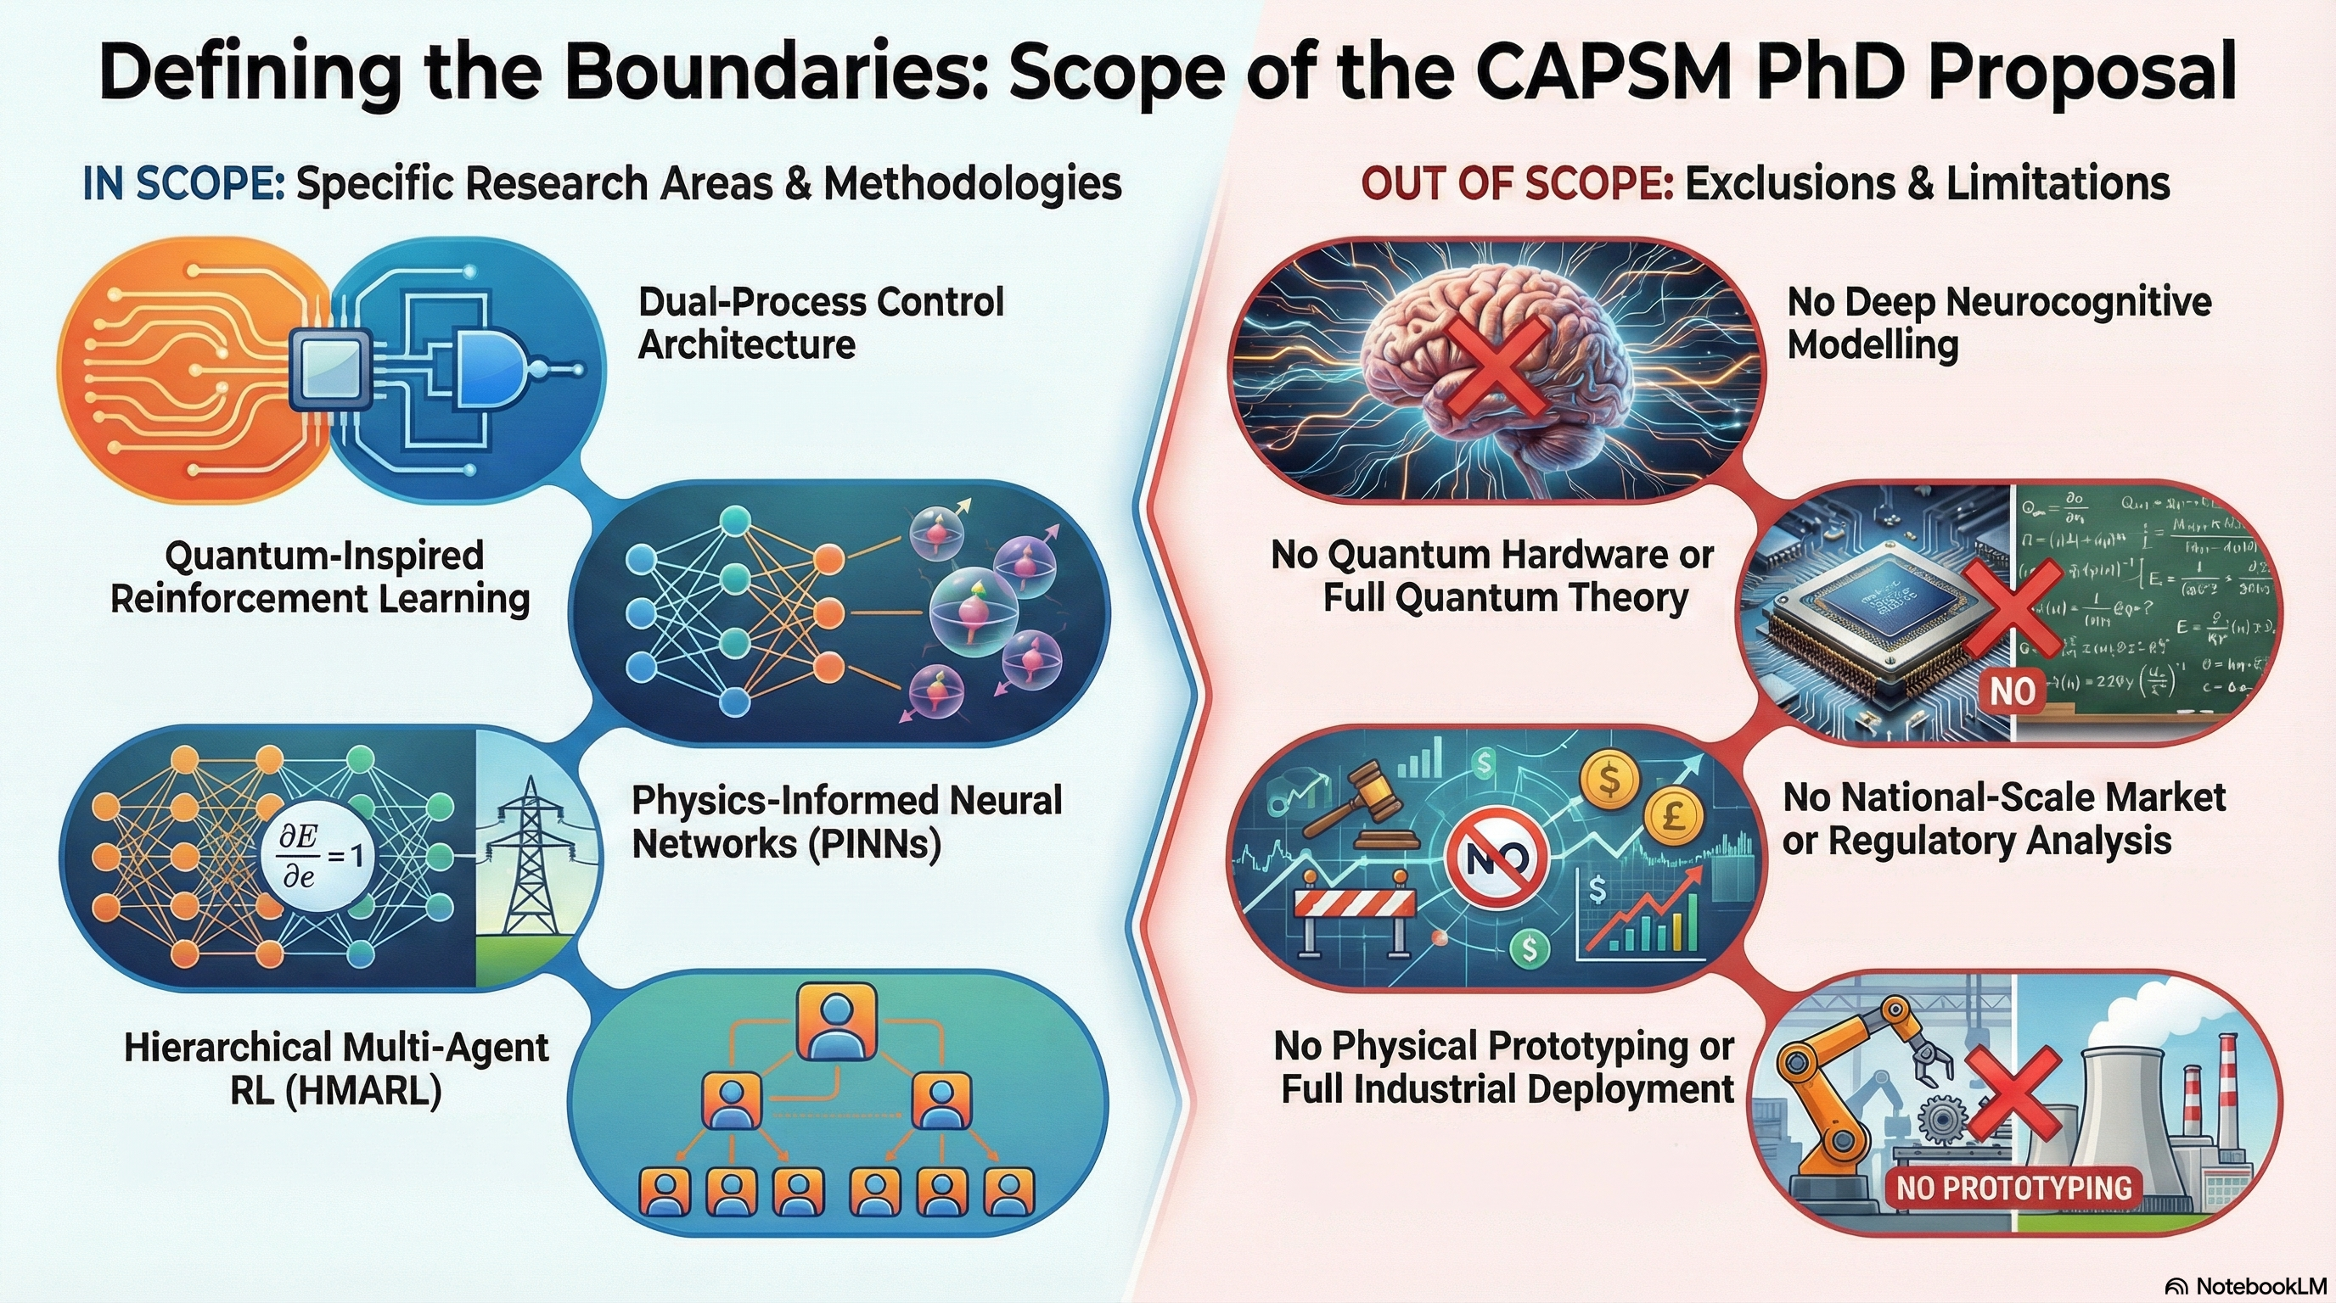
23

Slide 25
References – All
1] P. Karamanakos, E. Liegmann, T. Geyer, and R. Kennel, “Model Predictive Control of Power Electronic Systems: Methods, Results, and Challenges,” IEEE Open J. Ind. Appl., vol. 1, pp. 95–114, 2020, doi: 10.1109/OJIA.2020.3020184.
[2] S. Shahzad, M. A. Abbasi, M. A. Chaudhry, and M. M. Hussain, “Model Predictive Control Strategies in Microgrids: A Concise Revisit,” IEEE Access, vol. 10, pp. 122211–122225, 2022, doi: 10.1109/ACCESS.2022.3223298.
[3] E. Yaghoubi et al., “A Systematic Review and Meta-Analysis of Model Predictive Control in Microgrids: Moving Beyond Traditional Methods,” Processes, vol. 13, no. 7, p. 2197, July 2025, doi: 10.3390/pr13072197.
[4] M. Ghiasi, T. Niknam, Z. Wang, M. Mehrandezh, M. Dehghani, and N. Ghadimi, “A comprehensive review of cyber-attacks and defense mechanisms for improving security in smart grid energy systems: Past, present and future,” Electr. Power Syst. Res., vol. 215, p. 108975, Feb. 2023, doi: 10.1016/j.epsr.2022.108975.
[5] Y. Yasin Ghadi et al., “Security risk models against attacks in smart grid using big data and artificial intelligence,” PeerJ Comput. Sci., vol. 10, p. e1840, Apr. 2024, doi: 10.7717/peerj-cs.1840.
[6] R. R. Hossain et al., “Efficient Learning of Voltage Control Strategies via Model-based Deep Reinforcement Learning,” 2022, arXiv. doi: 10.48550/ARXIV.2212.02715.
[7] S. Nematshahi, D. Shi, F. Wang, B. Yan, and A. Nair, “Deep reinforcement learning based voltage control revisited,” IET Gener. Transm. Distrib., vol. 17, no. 21, pp. 4826–4835, Nov. 2023, doi: 10.1049/gtd2.13001.
[8] P. Wilk, N. Wang, and J. Li, “Multi-Agent Reinforcement Learning for Smart Community Energy Management,” Energies, vol. 17, no. 20, p. 5211, Oct. 2024, doi: 10.3390/en17205211.
[9] P. Yu, Z. Wang, H. Zhang, and Y. Song, “Safe Reinforcement Learning for Power System Control: A Review,” 2024, arXiv. doi: 10.48550/ARXIV.2407.00681.
[10] M. Raissi, P. Perdikaris, and G. E. Karniadakis, “Physics-informed neural networks: A deep learning framework for solving forward and inverse problems involving nonlinear partial differential equations,” J. Comput. Phys., vol. 378, pp. 686–707, Feb. 2019, doi: 10.1016/j.jcp.2018.10.045.
[11] S. Keren, C. Essayeh, S. V. Albrecht, and T. Morstyn, “Multi-Agent Reinforcement Learning for Energy Networks: Computational Challenges, Progress and Open Problems,” 2024, arXiv. doi: 10.48550/ARXIV.2404.15583.
[12] P. Wilk, N. Wang, and J. Li, “Multi-Agent Reinforcement Learning for Smart Community Energy Management,” Energies, vol. 17, no. 20, p. 5211, Oct. 2024, doi: 10.3390/en17205211.
[13] B. A. L. M. Hermans, S. Walker, J. H. A. Ludlage, and L. Özkan, “Model predictive control of vehicle charging stations in grid-connected microgrids: An implementation study,” Appl. Energy, vol. 368, p. 123210, Aug. 2024, doi: 10.1016/j.apenergy.2024.123210.
[14] Open Power System Data Team, “Open Power System Data,” Open Power System Data Project. Accessed: December 02, 2025. [Online]. Available: https://data.open-power-system-data.org/
[15] P. Karamanakos, E. Liegmann, T. Geyer, and R. Kennel, “Model Predictive Control of Power Electronic Systems: Methods, Results, and Challenges,” IEEE Open J. Ind. Appl., vol. 1, pp. 95–114, 2020, doi: 10.1109/OJIA.2020.3020184.
[16] S. Shahzad, M. A. Abbasi, M. A. Chaudhry, and M. M. Hussain, “Model Predictive Control Strategies in Microgrids: A Concise Revisit,” IEEE Access, vol. 10, pp. 122211–122225, 2022, doi: 10.1109/ACCESS.2022.3223298.
[17] R. R. Hossain et al., “Efficient Learning of Voltage Control Strategies via Model-based Deep Reinforcement Learning,” 2022, arXiv. doi: 10.48550/ARXIV.2212.02715.
[18] T. Zhao, J. Wang, and M. Yue, “A Barrier-Certificated Reinforcement Learning Approach for Enhancing Power System Transient Stability,” IEEE Trans. Power Syst., vol. 38, no. 6, pp. 5356–5366, Nov. 2023, doi: 10.1109/TPWRS.2022.3233770.
[19] P. Yu, Z. Wang, H. Zhang, and Y. Song, “Safe Reinforcement Learning for Power System Control: A Review,” 2024, arXiv. doi: 10.48550/ARXIV.2407.00681.
[20] M. Raissi, P. Perdikaris, and G. E. Karniadakis, “Physics-informed neural networks: A deep learning framework for solving forward and inverse problems involving nonlinear partial differential equations,” J. Comput. Phys., vol. 378, pp. 686–707, Feb. 2019, doi: 10.1016/j.jcp.2018.10.045.
[21] H. Bevrani, Robust Power System Frequency Control. Boston, MA: Springer US, 2009. doi: 10.1007/978-0-387-84878-5.
[22] S. Keren, C. Essayeh, S. V. Albrecht, and T. Morstyn, “Multi-Agent Reinforcement Learning for Energy Networks: Computational Challenges, Progress and Open Problems,” 2024, arXiv. doi: 10.48550/ARXIV.2404.15583.
[23] P. Wilk, N. Wang, and J. Li, “Multi-Agent Reinforcement Learning for Smart Community Energy Management,” Energies, vol. 17, no. 20, p. 5211, Oct. 2024, doi: 10.3390/en17205211.
[24] M. Ghiasi, T. Niknam, Z. Wang, M. Mehrandezh, M. Dehghani, and N. Ghadimi, “A comprehensive review of cyber-attacks and defense mechanisms for improving security in smart grid energy systems: Past, present and future,” Electr. Power Syst. Res., vol. 215, p. 108975, Feb. 2023, doi: 10.1016/j.epsr.2022.108975.
[25] Y. Yasin Ghadi et al., “Security risk models against attacks in smart grid using big data and artificial intelligence,” PeerJ Comput. Sci., vol. 10, p. e1840, Apr. 2024, doi: 10.7717/peerj-cs.1840.
[26] B. A. L. M. Hermans, S. Walker, J. H. A. Ludlage, and L. Özkan, “Model predictive control of vehicle charging stations in grid-connected microgrids: An implementation study,” Appl. Energy, vol. 368, p. 123210, Aug. 2024, doi: 10.1016/j.apenergy.2024.123210.
24

Slide 26
References – Part 1
Publication | Relevancy to Thesis
A proposed controller for real-time management of electrical vehicle battery fleet with MATLAB/SIMULINK Elsevier, 2025 | Supplies methods for EV/V2G operational control; forms the basis for EV coordination and System-2 optimization.
A comprehensive review of the current status of smart grid technologies for renewable energies integration and future trends: The role of machine learning and energy storage, Energies, 2024 | Provides foundational context on smart grid challenges; key research gaps motivating the CAPSM architecture are identified.
Enhancing fire protection in electric vehicle batteries through thermal energy storage and machine learning using Simulink, Fire, 2024 | Contributes safety-critical modeling; supports PINN-based constraint enforcement and safety layers.
Evaluating solar power forecasting robustness: A comparative analysis of XGBoost, RNN, KNN, RF, and LSTM with emphasis on lagged steps sensitivity and cross-validation techniques, IEEE Conference, 2024 | Offers renewable variability insights; provides disturbance inputs for RL and planning layers.
Enhancing wind power forecasting accuracy in Canada using a solar data-enhanced hybrid machine learning model: Integrating ANN, LSTM, and SVR, IEEE Conference 2024 | Provides enhanced forecasting methods; strengthens forecast-driven adaptive control.
Comparative analysis of machine learning techniques for an hour-ahead forecasting of electric vehicle states, Master Thesis, 2023 | Improves understanding of EV SoC and charging patterns; supports multi-agent EV modeling and SoC constraints.
AI-driven control strategies for FACTS devices in power quality management: A comprehensive review, Applied Science, 2025 | Identifies FACTS control limitations; directly motivates hierarchical multi-agent coordination (HMARL).
Climate-adaptive residential demand response with power quality-aware optimization using distributed generation systems, Electronics, 2025 | Introduces multi-objective optimization; supports System-2 cost–PQ–stability trade-off modeling.
25

Slide 27
References – Part 2
Prior Approach | Full Supporting Publications
Centralized MPC / OPF for Power Electronics and Microgrids | [15] Model Predictive Control of Power Electronic Systems: Methods, Results, and Challenges (Karamanakos et al.), [16] Model Predictive Control Strategies in Microgrids: A Concise Revisit (Shahzad et al.)
Model-Based Deep Reinforcement Learning for Voltage/Power Control | [17] Efficient Learning of Voltage Control Strategies via Model-based Deep Reinforcement Learning (Hossain et al.)
Safe RL with Barrier Certificates / Lyapunov Stability | [18] A Barrier-Certificated Reinforcement Learning Approach for Enhancing Power System Transient Stability (Zhao et al.), [19] Safe Reinforcement Learning for Power System Control: A Review (Yu et al.)
Physics-Informed Neural Networks (PINNs) | [20] Physics-Informed Neural Networks: A Deep Learning Framework for Solving Forward and Inverse Problems Involving Nonlinear Partial Differential Equations (Raissi et al.)
Heuristic / Classical Frequency and Protection Control | [21] Robust Power System Frequency Control (Bevrani)
Multi-Agent RL for Energy Networks and Smart Communities | [22] Multi-Agent Reinforcement Learning for Energy Networks: Computational Challenges, Progress and Open Problems (Keren et al.), [23] Multi-Agent Reinforcement Learning for Smart Community Energy Management (Wilk et al.)
Cybersecurity and Smart Grid Anomaly Detection | [24] A Comprehensive Review of Cyber-Attacks and Defense Mechanisms for Improving Security in Smart Grid Energy Systems: Past, Present and Future (Ghiasi et al.), [25] Security Risk Models Against Attacks in Smart Grid Using Big Data and Artificial Intelligence (Ghadi et al.)
EV / V2G Dispatch and Charging MPC | [26] Model Predictive Control of Vehicle Charging Stations in Grid-Connected Microgrids: An Implementation Study (Hermans et al.)
26

Slide 28
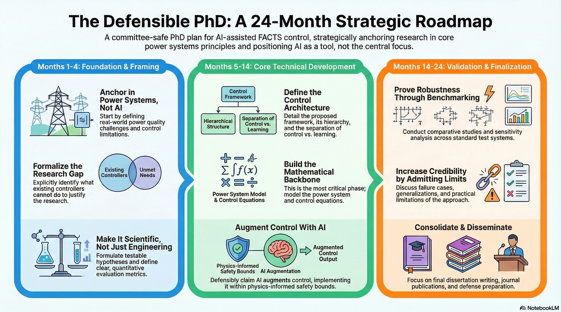
27

